Slide 1
Developing Blockchain Applications
Dario Alvarez - 2017

Slide 2
Content
What’s the blockchain
Origins
Types of blockchains
Business cases (ie. for health funds)
Non for profit cases
Developing blockchain applications using Ethereum

Slide 3
Blockchain technology definition
Data structure that stores time-ordered data
Ever growing list
Like an accounting ledger
Each “block” contains transactions that represent “change of state”
Distributed, decentralized, secure/encrypted transactions

Slide 4
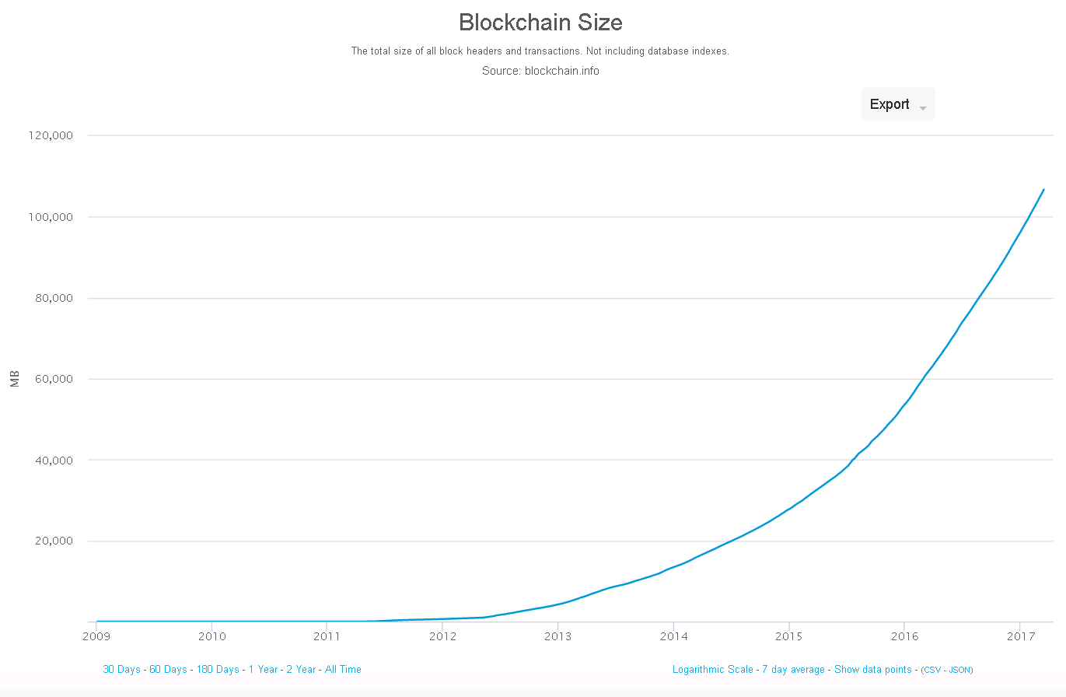

Slide 5
Origins
Bitcoin paper: released in 2008 under the name of Satoshi Nakamoto
Satoshi : wise
Naka: relationship
Moto: origin

Slide 6
Types of Blockchains
Public
Consortium (hybrid)
Private

Slide 7
Public Blockchains
Digital currencies
Bitcoin (decentralized currency)
Ethereum (decentralized application market)

Slide 8
Consortium Blockchains
A group of Institutions own the Blockchain

Slide 9
Private Blockchains
Controversial
Centralization of an decentralized underlying technology
Some banks are using it for “Auditing”

Slide 10
Private Blockchains
Multichain
Open source technology
An extension of bitcoin core (bitcoin compatible)
Customizable
Managed permissions

Slide 11
Business cases for Blockchains
Public ledger
Public notary (ie. Proofofexistance.com)

Slide 12
Business cases for Blockchains
On the case of Health Funds:
“a trend toward new use cases is emerging, and one industry that is ripe for optimization and increased efficiency using this technology is healthcare.“ Bitcoinmagazine.com

Slide 13
Business cases for Blockchains
On the case of Health Funds:
“The ability to have insurance companies, hospital billing departments, lenders, and patients using one blockchain to manage payments could reduce redundancies across the entire industry” bitcoinmagazine.com

Slide 14
Business cases for Blockchains
Voter Registration and Secure Vote Counting
Digital Identities for Refugees
Recording Land Ownership
Tracking Financial Donations

Slide 15
Non for profit cases for Blockchains
“UNICEF is funding blockchain and health tech to solve the world’s biggest problems” http://unicefstories.org
9Needs Pvt Ltd

Slide 16
Blockchain development
Why Ethereum ?
SmartContracts

Slide 17
SmartContracts
Autonomous (no need for a lawyer)
Trust (encrypted and stored on shared ledgers)
Backups (info will never get lost)
Safety (encrypted – nearly impossible to be hacked – there should be a consensus for that)
Speed
Saves money
Accuracy

Slide 18
Ethereum ecosystem
Code runs on a Ethereum VM
Contracts are coded on a language called solidity
http://dapps.ethercasts.com/
CLI tools https://ethereum.org/cli

Slide 19
Ethereum ecosystem
Code runs on a Ethereum VM
Contracts are coded on a language called solidity
http://dapps.ethercasts.com/
CLI tools https://ethereum.org/cli
Ether is used to pay for computation
http://ethdocs.org/en/latest/ether.html

Slide 20
Building SmartContracts
Browser solidity:
http://ethereum.github.io/browser-solidity/#version=0.3.6

Slide 21
Building SmartContracts
Ethereum development frameworks:
Truffle
Integration with node
Contract linking and compilation
Contract testing framework
http://truffleframework.com/
https://github.com/ConsenSys/truffle
https://truffle.readthedocs.io/en/latest/getting_started/contracts/

Slide 22
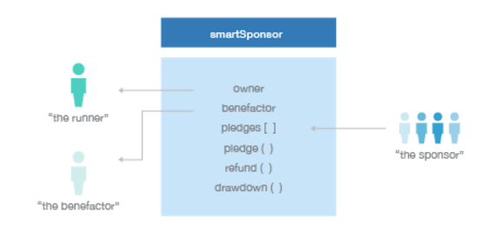
Building SmartContracts
Contract example:
SmartSponsor

Slide 23
Building SmartContracts
smartSponsor – the contract’s constructor. It initialises the contract’s state. The creator of the contract nominates the address of the account that will benefit when the contract is drawn down
pledge – can be called by anyone to donate Ether to the sponsorship fund. The sponsor supplies an optional message of support
getPot – returns the current total of Ether stored in the contract
refund – sends the sponsor money back to the sponsors. Only the contract’s owner can call this function
drawdown – sends total value of the contract to the benefactor account. Again, only the contract’s owner can call this function

